Slide 1
Summer Project
August 4, 2023
Smit Goradia
Tejas Nemlekar
Kanchan Murumkar
Notes:
Shreya

Slide 2
Why Do U.S. Firms Hold So Much More Cash than They Used To?
-THOMAS W. BATES, KATHLEEN M. KAHLE, RENÉ M. STULZ
THE JOURNAL OF FINANCE • VOL. LXIV, NO. 5 • OCTOBER 2009

Slide 3
Introduction
The rise in U.S. firms' cash holdings has become a significant trend, raising concerns and interest among researchers and policymakers. Understanding the reasons behind this surge in cash reserves is crucial for assessing its impact on corporate decision-making, investment, and overall economic performance.
The paper also discusses the impact of firm characteristics and changes in the business environment on cash ratios. It provides empirical evidence and regression models to analyze the determinants of cash holdings.
Overall, the document provides a comprehensive analysis of the reasons behind the increase in cash holdings by U.S. firms and its implications.

Slide 4
Data used
CRSP (Center for Research in Security Prices) | Compustat | Kenneth French Data Library
We obtained CRSP data through WRDS to access information about stock returns, prices, and market values for the sample of US firms over the study period (1980 to 2022). | We accessed Compustat data through WRDS to obtain a rich set of variables, including market value, cash flow, firm size, dividend dummy, net working capital, leverage, R&D expenses, acquisitions, interest expense, common dividends, cash and marketable securities, earnings, and net assets. | We used data from the Kenneth French Data Library to access important factors like the market risk factor (Mkt-RF), size factor (SMB), and value factor (HML), which are part of the Fama-French three-factor model.

Slide 5
Methodologies
Cash and Leverage Ratios:
Calculated cash ratio as cash and marketable securities to total assets.
Defined leverage as total debt to total assets.
Computed net leverage by adjusting total debt with cash.
Analysis of IPO and Non-IPO Firms:
Classified firms as IPO (within 5 yrs) and non-IPO subsamples.
We expanded the analysis by incorporating more recent data and evolving trends in cash holding patterns and determinants
.

Slide 6
Methodologies
Regression Analysis:
Utilized comprehensive explanatory variables for robust analysis.
Aimed to provide reliable insights into cash holding determinants.
Extension Methodologies:
Created Long-short portfolio based on decile buckets of average cash ratios.
Provided valuable insights for investment decision-making.
.

Slide 7
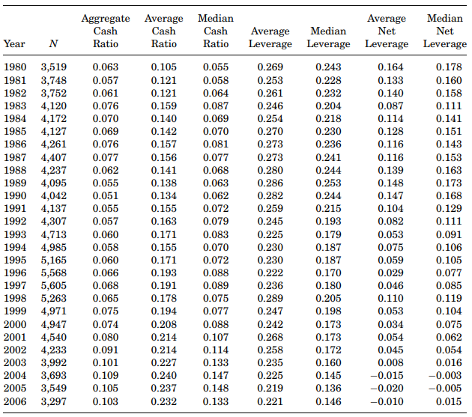
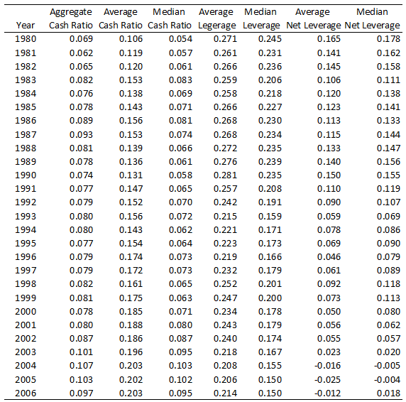
Replication Table I:
Average and Median Cash and Leverage Ratios from 1980 to 2006
Notes:
1) Table 1 in the research paper includes all Compustat firm-year observations from 1980 to 2006 for firms incorporated in the United States excluding Financial firms (SIC code 6000-6999) and utilities (SIC codes 4900-4999). We have successfully replicated Table 1 of the research paper by extracting all the relevant observations from the WRDS merged CRSP/Compustat files. Through this process, we have obtained similar observations as reported in the research paper for Aggregate Cash Ratio, Average Cash ratio and Median Cash and Leverage Ratios.
2)The results we got are similar to the findings of the research paper i.e Avg cash ratio increases from 10.5% in 1980 to 23.2% in 2006. The same trend is conveyed by the median and Agg cash ratio
3) the average net leverage ratio is calculated by subtracting cash from debt, the average net debt ratio is 16.4% in 1980 and it falls
during 15 years and becomes negative in the last 3 years of the sample. By 2006, the average firm has no leverage when leverage is measured by net debt which confirms the findings of the research paper that cash enables firms to prevent distress and default as it can retire all debt obligations with its cash
holdings. Thus the growing importance of cash should be taken into account when evaluating the financial condition and assessing the capital structure decisions of firms

Slide 8
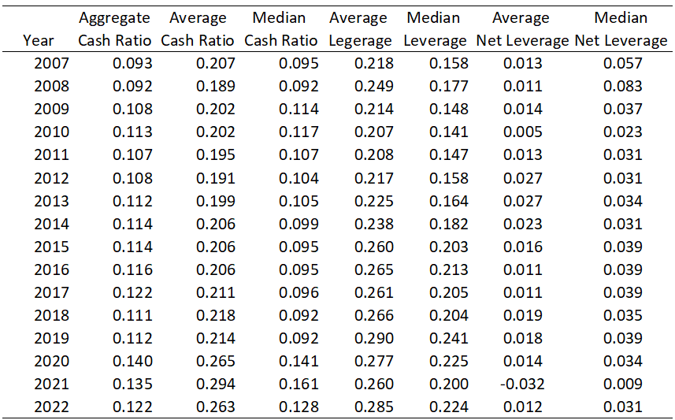
Extension Table I:
Extension
Notes:
1) Now, for the extension part, the related literature have used data up until 2006 and our paper incorporates more recent data from 2007 till 2022, potentially capturing any shifts or changes in cash holdings patterns and determinants that have occurred in the intervening period
2)The results we got in this extension are similar to the findings of the research paper i.e the cash holdings of US Firms are increasing each year and Net Leverage ratio is decreasing.

Slide 9
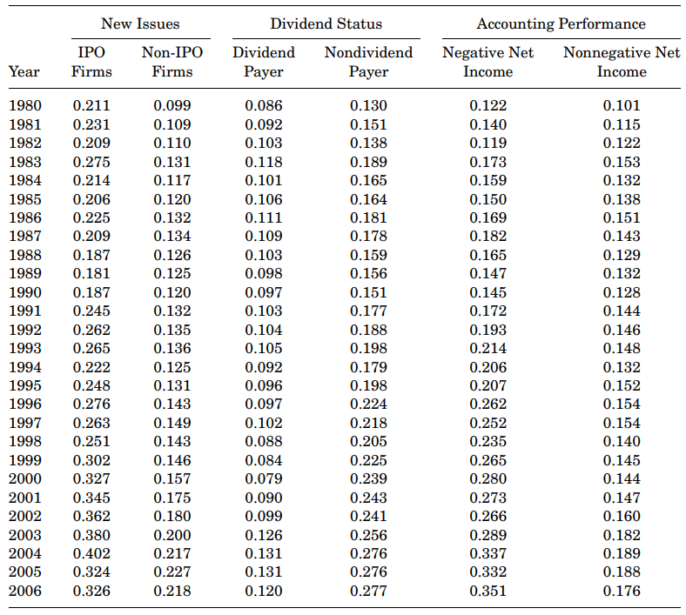
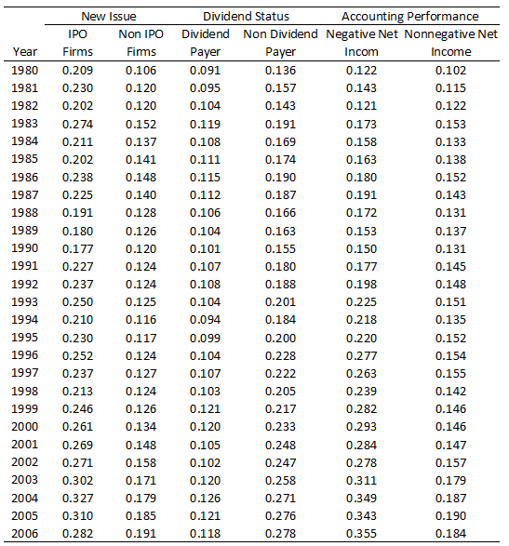
Replication Table II:
Average Cash Ratios from 1980 to 2006 Delineated by New Issue Status, the Payment of Dividends, and Accounting Performance
Notes:
1)Table 2 shows the Average Cash ratios delineated by New Issue Status, the Payment of Dividends, and Accounting Performance for all Compustat firms from 1980 to 2006 excluding Financial firms (SIC code 6000-6999) and utilities (SIC codes 4900-4999) and we have successfully replicated Table 2
2)Firms are assigned to the IPO subsample if they have gone public within the prior 5 calendar years, and to the non-IPO subsample otherwise. A firm is classified as a dividend payer if it paid common dividends in that year. Firms with accounting losses at the fiscal end of the designated year are assigned to the negative net income subsample.
3)Through this process, we have obtained similar observations as reported in the research paper i.e The average cash ratio more than doubles (from 9.9% to 21.8%) for non-IPO firms and The average cash ratio for IPO firms is 21.1% in 1980 and 32.6% in 2006. The ratios are significant for both are significant for both IPO and non-IPO firms. This evidence shows that the increase in cash holdings is not just due to the capital raising activities of the IPO firms in our sample.
4) Now, turning to the role of dividends, the average cash ratio of dividend payers is about the same in 2000 as in 1980 and in contrast, the average
cash ratio of nondividend payers is 113% higher in 2006 than in 1980. This is similar to the findings of the research paper that nondividend paying firms are financially constrained and will accumulate more cash due to poor growth opportunities.
5)Firms with negative net income are more likely to be financially constrained than firms with positive net income. The firms with negative net income exhibit
a dramatic increase in cash holdings. The average cash ratio of these firms almost triples over the sample period.(12% in 1980 and 36% in 2006)

Slide 10
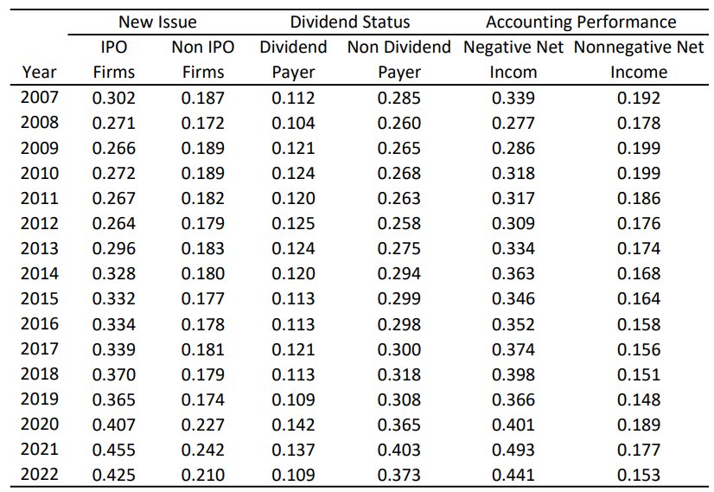
Extension Table II:
Extension
Notes:
1) Now, for the extension part we have incorporated more recent data from 2007 till 2022, potentially capturing any shifts or changes in cash holdings patterns and determinants that have occurred in the intervening period
2)The results we got in this extension are similar to the findings of the research paper I mentioned in the previous slide about IPO & Non- IPO Firms, Non Dividend paying firms and firms with Negative Net Income.

Slide 11
New Extension:
Hypothesis: The cash ratio of a company does not significantly impact its portfolio returns beyond what can be explained by the traditional market, size, and value factors.
Methodology: .Categorizing firms from 1980 to 2022 by their average cash ratio led to a Long-short portfolio strategy. This approach involved acquiring high cash ratio decile firms and divesting from low cash ratio decile firms. Annual portfolio returns were calculated and regressed against Fama-French factors: Mkt-RF, HML, and SMB.
Expectations: Based on the conducted analysis and regression model, it is anticipated that the research will reveal a statistically significant relationship between the cash ratio of companies and their portfolio returns.
Notes:
The coefficient of the intercept term (Alpha) is expected to have a non-zero value with a significant p-value, indicating that the cash ratio plays a significant role in influencing portfolio returns beyond the traditional market, size, and value factors.

Slide 12
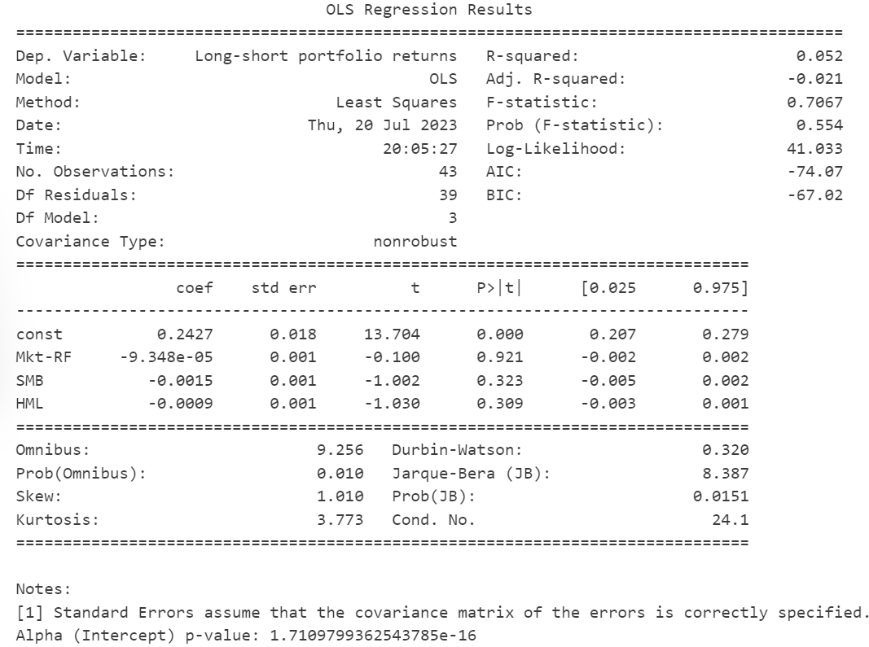
New Extension:
Notes:
1)We performed another extension in which we segregated all the firms from 1980 till 2022 in decile buckets based on their average cash ratio. Then we created a Long-short portfolio by buying the firms in the highest cash ratio bucket i.e 9 and selling firms in the lowest cash ratio bucket i.e 0. We then used the annual returns data to get the differential returns of this long-short portfolio by subtracting sell bucket returns from the buy bucket returns. Afterwards, we regressed this return series data on the FF 3 Factors.
The positive Alpha value (const: 0.2427) indicates that the Long-short portfolio, which consists of companies in the Big bucket portfolio (high cash ratios) and companies in the Sell bucket portfolio (low cash ratios), is expected to outperform the market and the Fama-French factors (Mkt-RF, SMB, and HML) alone.
Since the p-value is very close to zero, we can conclude that the Alpha (intercept) is statistically significant. It indicates that there is a significant excess return in the Long-short portfolio which is not explained by the market, size, and value factors (Mkt-RF, SMB, and HML).

Slide 13
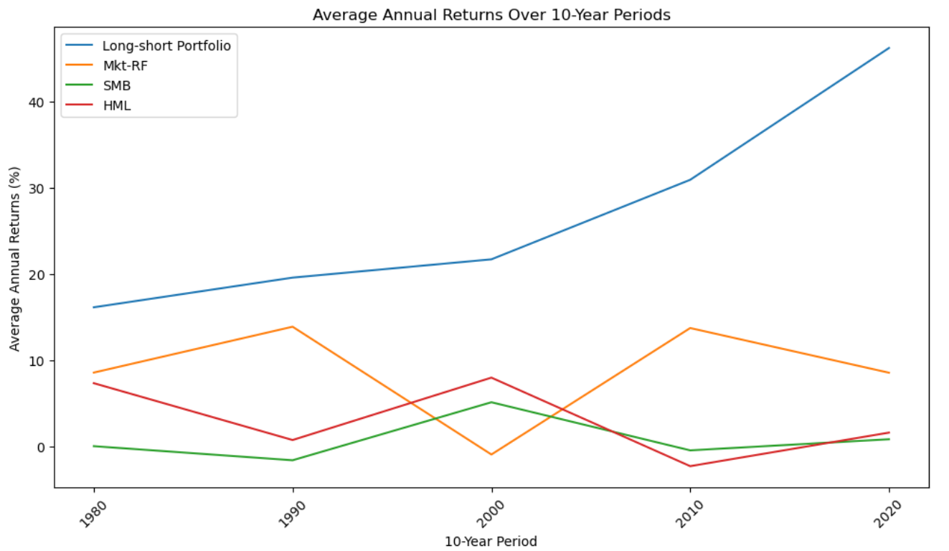
Visualizing Portfolio Returns and Factor Dynamics

Slide 14
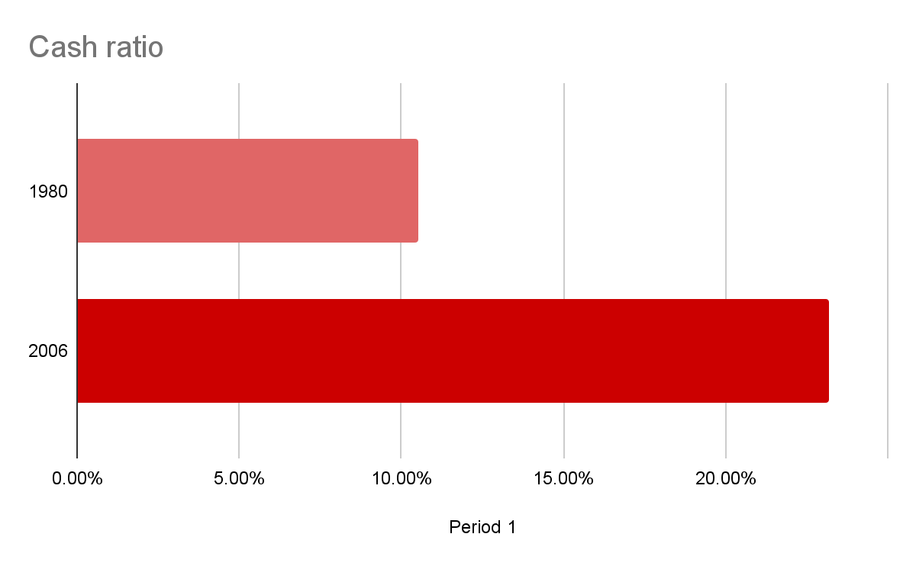
Regressions estimating the determinants of cash holdings
In a regression of the average cash-to-assets ratio on a constant and time, time has a significantly positive coefficient, implying that the average cash-to-assets ratio (the cash ratio) has increased by 0.46% per year.
Another way to see this evolution is that the average cash ratio more than doubles over our sample period, from 10.5% in 1980 to 23.2% in 2006.
Notes:
Tejas

Slide 15
Data Used
The important data used in the regressions estimating the determinants of cash holdings include variables such as market value, cash flow, firm size, dividend dummy, net working capital, leverage, R&D expenses, acquisitions, interest expense, common dividends, cash and marketable securities, earnings, and net assets.
These variables are used to analyze the factors that influence the level of cash holdings in firms.
2022
1980

Slide 16
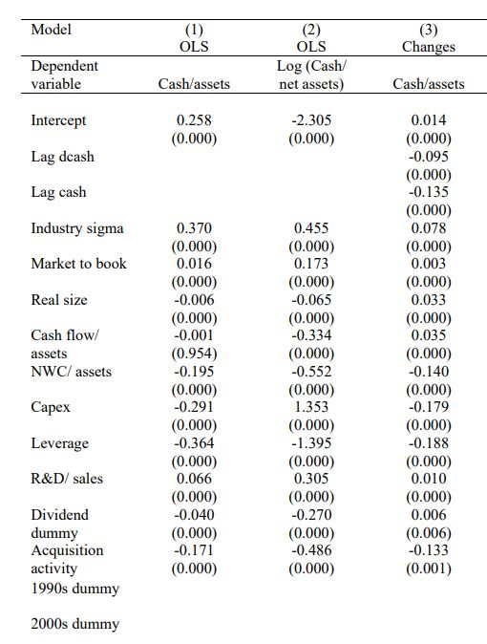
Table III:
The study conducted regressions to estimate the determinants of cash holdings. The results showed that there are several factors that influence cash holdings
Changes in firm characteristics: The study used the model to assess how changes in firm characteristics relate to cash holdings. Factors such as cash flow, firm size, and the dividend dummy were found to have significant coefficients in explaining cash holdings.
Notes:
-ADD MODEL 4,5 AND 6
-We find that the
main reasons for the increase in the cash ratio are that inventories have fallen,
cash flow risk for firms has increased, capital expenditures have fallen, and
R&D expenditures have increased
-Market-to-book ratio. Firms with better investment opportunities value
cash more since it is costly for these firms to be financially constrained.
We use the book value of assets (#6) minus the book value of equity (#60)
plus the market value of equity (#199 ∗ #25) as the numerator of the ratio
and the book value of assets (#6) as the denominator.
2. Firm size. There are economies of scale to holding cash.We use as our size
measure the logarithm of book assets (#6) in 2004 dollars.
3. Cash flow to assets. We measure cash flow as earnings after interest, dividends,
and taxes but before depreciation divided by book assets ((#13 –
#15 – #16 – #21) / #6). Firms with higher cash flow accumulate more cash,
all else equal. Such firms might have better investment opportunities, but
we control for these through other variables.
4. Net working capital to assets. Net working capital (NWC) consists of assets
that substitute for cash.We thus expect a negative relation between NWC
and cash holdings. We subtract cash (#1) from NWC (#179), so our NWC
measure is net of cash.
5. Capital expenditures to assets. We measure capital expenditures as the
ratio of capital expenditures (#128) to book assets (#6). If capital expenditures
create assets that can be used as collateral, capital expenditures
could increase debt capacity and reduce the demand for cash. Further, as
shown by Riddick and Whited (2009), a productivity shock that increases
investment can lead firms to temporarily invest more and save less cash,
which would lead to a lower level of cash. At the same time, capital expenditures
could proxy for financial distress costs and/or investment opportunities,
in which case they would be positively related to cash.
6. Leverage. We measure leverage as long-term debt (#9) plus debt in current
liabilities (#34) divided by book assets (#6). If debt is sufficiently
constraining, firms will use cash to reduce leverage, resulting in a negative
relation between cash holdings and leverage.
-7. Industry cash flow risk.We expect firms with greater cash flow risk (measured
as discussed in Section III) to hold more precautionary cash.
8. Dividend payout dummy. We define a dummy variable equal to one in
years in which a firm pays a common dividend (#21). Otherwise, the
dummy equals zero. Firms that pay dividends are likely to be less risky
and have greater access to capital markets, so the precautionary motive
for cash holdings is weaker for them.
9. R&D to sales. This variable also measures growth opportunities. Firms
with greater R&D are assumed to have greater costs of financial distress.
R&D expenditures consume cash, but R&D’s role as a proxy for growth
opportunities and financial distress could lead to a positive relation between
the cash ratio and R&D spending. R&D is measured as R&D (#46)
/ sales (#12), and is set equal to zero when R&D (#46) is missing. Results
are similar if we use R&D/assets.
10. Acquisitions to assets. Acquisition activity is defined as acquisitions (#129)
/ book assets (#6), where acquisition expenditures reflect only the cash
outflows associated with acquisitions. We would expect the sign on this
coefficient to be the same as the sign for capital expenditures.

Slide 17
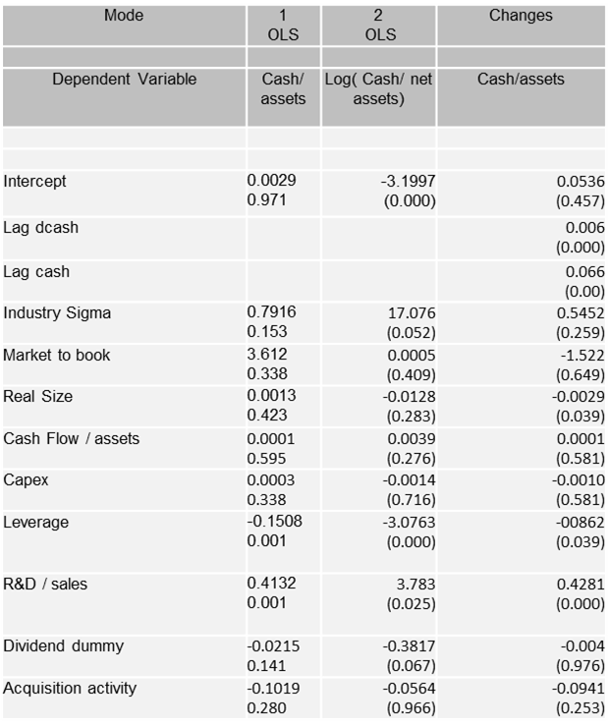
Pooled regressions: The study compared its findings to previous studies that used pooled regressions. The coefficients on the modeled factors yielded slightly different results in sign and significance, but overall, the findings were generally robust. Changes over time: The study investigated changes over time in the coefficients related to cash holdings. The results showed that the absolute value of coefficients generally increased over time, with some exceptions.
Notes:
-ADD MODEL 4,5 AND 6
-We find that the
main reasons for the increase in the cash ratio are that inventories have fallen,
cash flow risk for firms has increased, capital expenditures have fallen, and
R&D expenditures have increased
-Market-to-book ratio. Firms with better investment opportunities value
cash more since it is costly for these firms to be financially constrained.
We use the book value of assets (#6) minus the book value of equity (#60)
plus the market value of equity (#199 ∗ #25) as the numerator of the ratio
and the book value of assets (#6) as the denominator.
2. Firm size. There are economies of scale to holding cash.We use as our size
measure the logarithm of book assets (#6) in 2004 dollars.
3. Cash flow to assets. We measure cash flow as earnings after interest, dividends,
and taxes but before depreciation divided by book assets ((#13 –
#15 – #16 – #21) / #6). Firms with higher cash flow accumulate more cash,
all else equal. Such firms might have better investment opportunities, but
we control for these through other variables.
4. Net working capital to assets. Net working capital (NWC) consists of assets
that substitute for cash.We thus expect a negative relation between NWC
and cash holdings. We subtract cash (#1) from NWC (#179), so our NWC
measure is net of cash.
5. Capital expenditures to assets. We measure capital expenditures as the
ratio of capital expenditures (#128) to book assets (#6). If capital expenditures
create assets that can be used as collateral, capital expenditures
could increase debt capacity and reduce the demand for cash. Further, as
shown by Riddick and Whited (2009), a productivity shock that increases
investment can lead firms to temporarily invest more and save less cash,
which would lead to a lower level of cash. At the same time, capital expenditures
could proxy for financial distress costs and/or investment opportunities,
in which case they would be positively related to cash.
6. Leverage. We measure leverage as long-term debt (#9) plus debt in current
liabilities (#34) divided by book assets (#6). If debt is sufficiently
constraining, firms will use cash to reduce leverage, resulting in a negative
relation between cash holdings and leverage.
-7. Industry cash flow risk.We expect firms with greater cash flow risk (measured
as discussed in Section III) to hold more precautionary cash.
8. Dividend payout dummy. We define a dummy variable equal to one in
years in which a firm pays a common dividend (#21). Otherwise, the
dummy equals zero. Firms that pay dividends are likely to be less risky
and have greater access to capital markets, so the precautionary motive
for cash holdings is weaker for them.
9. R&D to sales. This variable also measures growth opportunities. Firms
with greater R&D are assumed to have greater costs of financial distress.
R&D expenditures consume cash, but R&D’s role as a proxy for growth
opportunities and financial distress could lead to a positive relation between
the cash ratio and R&D spending. R&D is measured as R&D (#46)
/ sales (#12), and is set equal to zero when R&D (#46) is missing. Results
are similar if we use R&D/assets.
10. Acquisitions to assets. Acquisition activity is defined as acquisitions (#129)
/ book assets (#6), where acquisition expenditures reflect only the cash
outflows associated with acquisitions. We would expect the sign on this
coefficient to be the same as the sign for capital expenditures.

Slide 18
Conclusion
01
The concept of holding cash is based on the idea that firms hold cash as a buffer to deal with unexpected negative shocks or uncertainties.
Precautionary motive
02
Surge in cash-to-assets ratios
The average cash ratio growing from 10.3% in 1980 to 23.2% in 2006, and further to 26.3% in 2022.
03
We document a notable decrease in net debt, which is crucial to consider when evaluating a firm's leverage position.
Decrease in net debt
04
This research underscores the potential value of incorporating cash ratio deciles into investment decisions.
Unlocking Portfolio Potential:
Insights from Cash Ratios

Slide 19
Thank you!

Slide 20
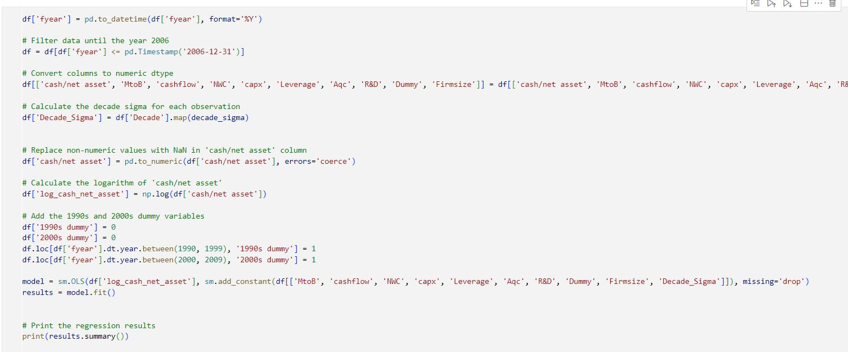
Appendix

Slide 21
